Slide 1
Evaluating Limits Graphically

Slide 2
Limits
Imagine someone is standing 10 metres from a wall. We tell that person to move halfway to the wall. We then tell them to again move halfway to the wall. We then tell them to again move halfway to the wall, and we continue to do this. Theoretically, the person will never reach the wall. However, we can say that as the number of trials moves to infinity, the limit of where the person is standing will be the wall.
Of course, the person will never reach the wall (theoretically), but we could still refer to the wall as the limit.

Slide 3
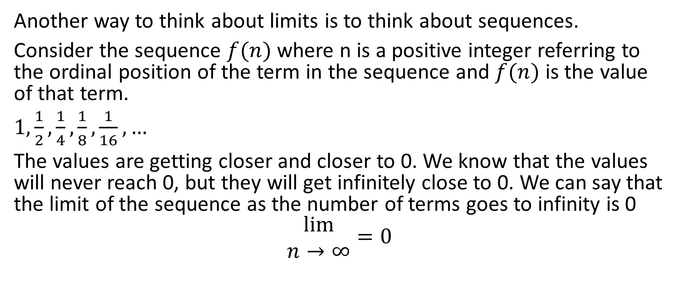
Another way to think about limits is to think about sequences.
Consider the sequence $f(n)$ where n is a positive integer referring to the ordinal position of the term in the sequence and $f(n)$ is the value of that term.
$1, \frac{1}{2},\frac{1}{4},\frac{1}{8},\frac{1}{16}, …$
The values are getting closer and closer to 0. We know that the values will never reach 0, but they will get infinitely close to 0. We can say that the limit of the sequence as the number of terms goes to infinity is 0
$$\begin{matrix}lim⁡ \\ n→∞\end{matrix}=0$$

Slide 4
In mathematics, a limit is the value that a function (or sequence) "approaches" as the input (or index) "approaches" some value. Limits are essential to calculus (and mathematical analysis in general) and are used to define continuity, derivatives, and integrals.

Slide 5
When dealing with functions, we can let the x-value inputted to the function grow closer and closer to some set value. We then watch the pattern of y-values to see if there is a set y-value that we grow infinitely close to. If there is such a value, we say that that is the value of the limit.

Slide 6
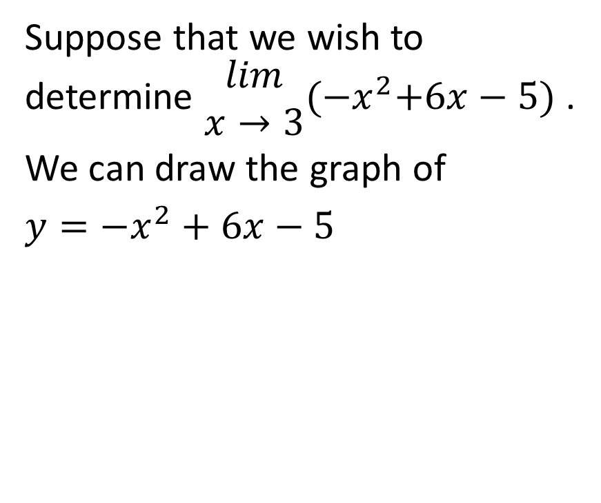
Example
Suppose that we wish to determine $\begin{matrix}lim \\ x→3\end{matrix}{(−x}^{2}+6x−5)$ .
We can draw the graph of
$y=−x^{2}+6x−5$

Slide 7
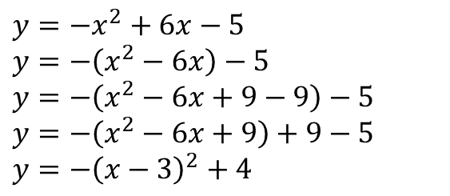
Suppose that we wish to determine $\begin{matrix}lim \\ x→3\end{matrix}{(−x}^{2}+6x−5)$ .
We can draw the graph of
$y=−x^{2}+6x−5$
$y=−x^{2}+6x−5$
$y=−\left(x^{2}−6x\right)−5$
$y=−\left(x^{2}−6x+9−9\right)−5$
$y=−\left(x^{2}−6x+9\right)+9−5$
$y=−{\left(x−3\right)}^{2}+4$

Slide 8
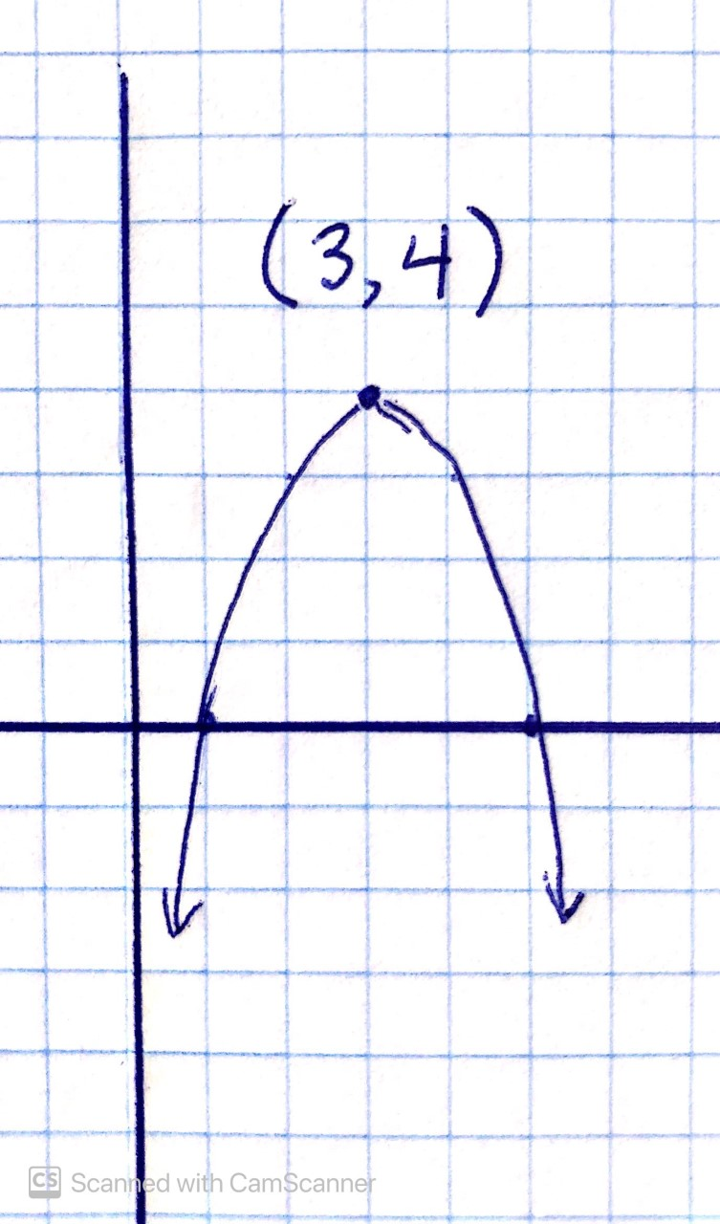
Suppose that we wish to determine $\begin{matrix}lim \\ x→3\end{matrix}{(−x}^{2}+6x−5)$ .
We can draw the graph of
$y=−x^{2}+6x−5$
$y=−x^{2}+6x−5$
$y=−\left(x^{2}−6x\right)−5$
$y=−\left(x^{2}−6x+9−9\right)−5$
$y=−\left(x^{2}−6x+9\right)+9−5$
$y=−{\left(x−3\right)}^{2}+4$

Slide 9
To determine the limit graphically, we will approach an x-value of 3 from the right side and from the left side, and we will see where the y value is heading.
In this analysis, we never actually arrive at an x-value of 3, we just approach the x-value of 3.

Slide 10
Let’s approach an x-value of 3 from the left hand side.

Slide 11
Let’s approach an x-value of 3 from the left hand side.
At an x-value of 1, the y-value is 0

Slide 12
Let’s approach an x-value of 3 from the left hand side.
At an x-value of 1, the y-value is 0
At an x-value of 2, the y-value is 3

Slide 13
Let’s approach an x-value of 3 from the left hand side.
At an x-value of 1, the y-value is 0
At an x-value of 2, the y-value is 3
At an x-value of 2.5, the y-value is 3.75

Slide 14
Let’s approach an x-value of 3 from the left hand side.
At an x-value of 1, the y-value is 0
At an x-value of 2, the y-value is 3
At an x-value of 2.5, the y-value is 3.75
At an x-value of 2.9, the y-value is 3.99

Slide 15
Let’s approach an x-value of 3 from the left hand side.
At an x-value of 1, the y-value is 0
At an x-value of 2, the y-value is 3
At an x-value of 2.5, the y-value is 3.75
At an x-value of 2.9, the y-value is 3.99
At an x-value of 2.99, the y-value is 3.9999

Slide 16

In other words, as we approach the x-value of 3 from the left hand side, we can see that the y-value approaches 4

Slide 17
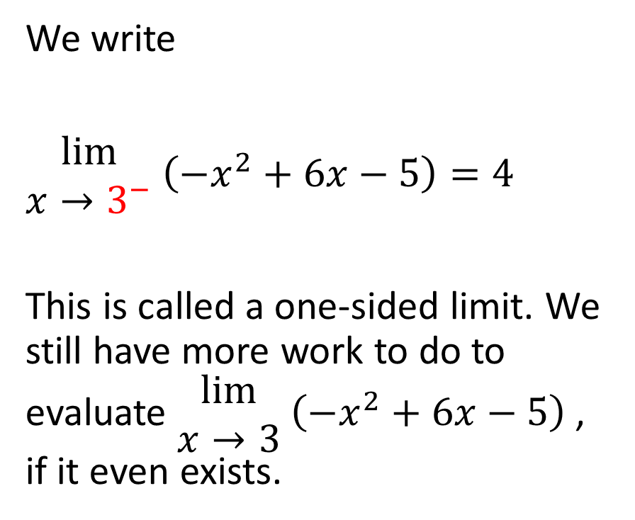
We write
$\begin{matrix}lim⁡ \\ x→3^{−}\end{matrix}$ $\left(−x^{2}+6x−5\right)=4$
This is called a one-sided limit. We still have more work to do to evaluate $\begin{matrix}lim⁡ \\ x→3\end{matrix}$ $\left(−x^{2}+6x−5\right)$ , if it even exists.

Slide 18
Now, let’s approach an x-value of 3 from the right hand side

Slide 19
At an x-value of 5, the y-value is 0

Slide 20
At an x-value of 5, the y-value is 0
At an x-value of 4, the y-value is 3

Slide 21
At an x-value of 5, the y-value is 0
At an x-value of 4, the y-value is 3
At an x-value of 3.5, the y-value is 3.75

Slide 22
At an x-value of 5, the y-value is 0
At an x-value of 4, the y-value is 3
At an x-value of 3.5, the y-value is 3.75
At an x-value of 3.1, the y-value is 3.99

Slide 23
At an x-value of 5, the y-value is 0
At an x-value of 4, the y-value is 3
At an x-value of 3.5, the y-value is 3.75
At an x-value of 3.1, the y-value is 3.99
At an x-value of 3.01, the y-value is 3.9999

Slide 24

In other words, as we approach the x-value of 3 from the right hand side, we can see that the y-value approaches 4

Slide 25
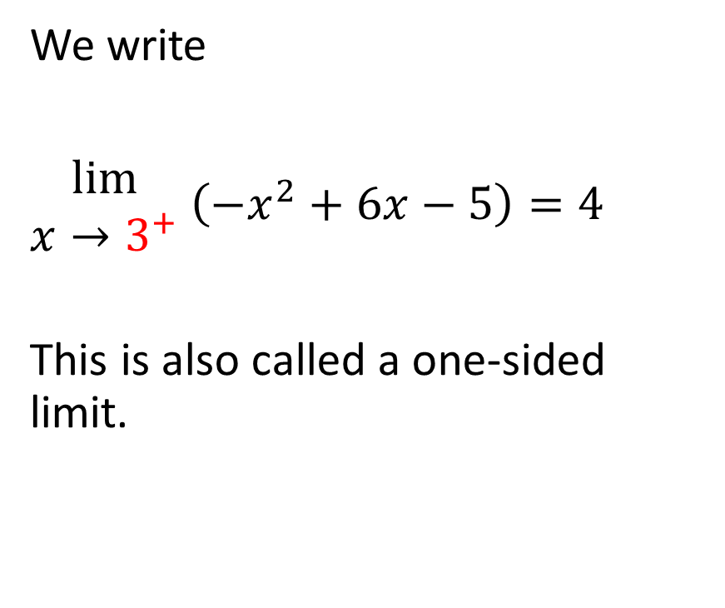

We write
$\begin{matrix}lim⁡ \\ x→3^{+}\end{matrix}$ $\left(−x^{2}+6x−5\right)=4$
This is also called a one-sided limit.

Slide 26
Now that we know the limit of the function as x approaches 3 from the left and the limit of the function as x approaches 3 from the right, we compare them to see if they are equal.

Slide 27
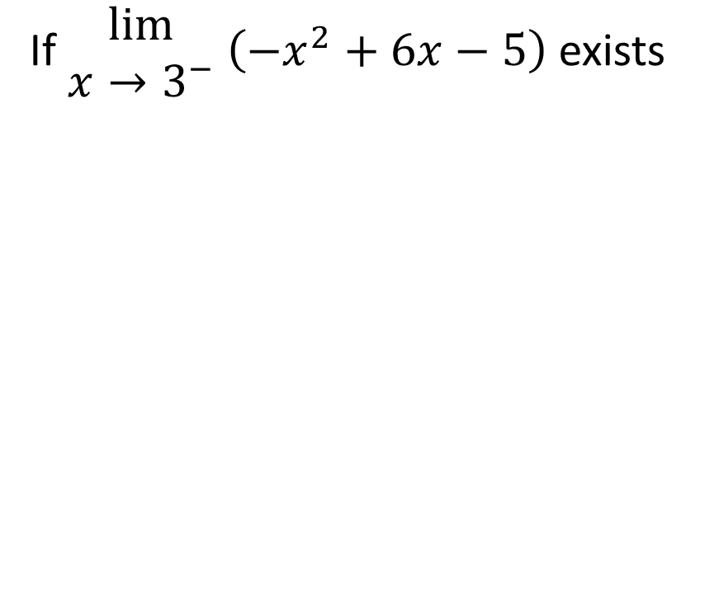

If $\begin{matrix}lim⁡ \\ x→3^{−}\end{matrix}$ $\left(−x^{2}+6x−5\right)$ exists

Slide 28
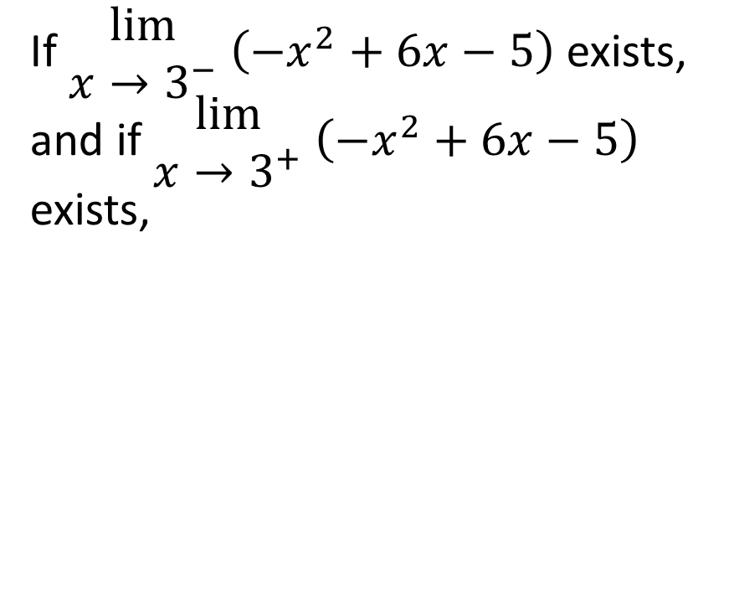
If $\begin{matrix}lim⁡ \\ x→3^{−}\end{matrix}$ $\left(−x^{2}+6x−5\right)$ exists, and if $\begin{matrix}lim⁡ \\ x→3^{+}\end{matrix}$ $\left(−x^{2}+6x−5\right)$ exists,

Slide 29

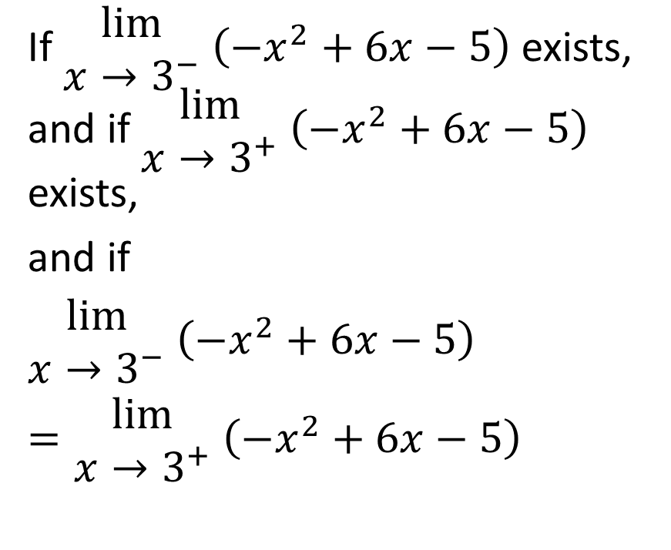
If $\begin{matrix}lim⁡ \\ x→3^{−}\end{matrix}$ $\left(−x^{2}+6x−5\right)$ exists, and if $\begin{matrix}lim⁡ \\ x→3^{+}\end{matrix}$ $\left(−x^{2}+6x−5\right)$ exists,
and if
$\begin{matrix}lim⁡ \\ x→3^{−}\end{matrix}$ $\left(−x^{2}+6x−5\right)$
$=\begin{matrix}lim⁡ \\ x→3^{+}\end{matrix}$ $\left(−x^{2}+6x−5\right)$

Slide 30
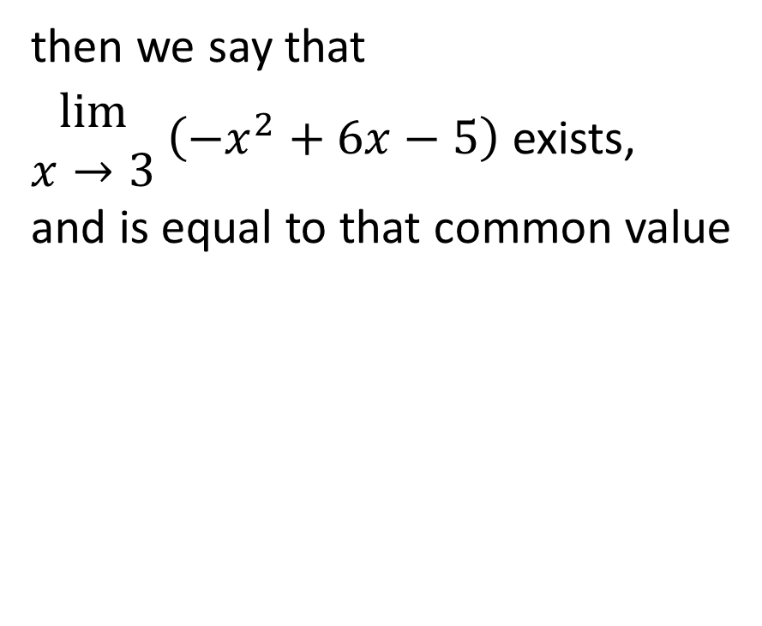
then we say that
$\begin{matrix}lim⁡ \\ x→3\end{matrix}$ $\left(−x^{2}+6x−5\right)$ exists,
and is equal to that common value

Slide 31
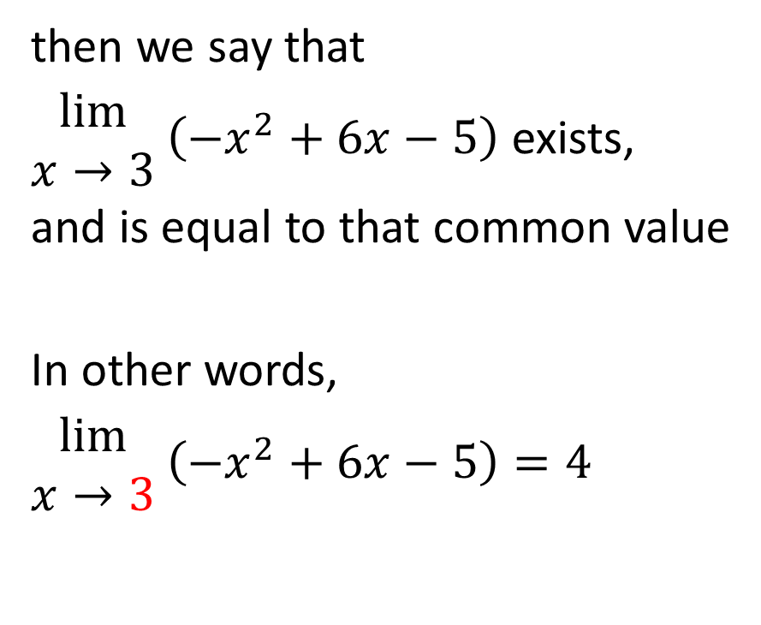
then we say that
$\begin{matrix}lim⁡ \\ x→3\end{matrix}$ $\left(−x^{2}+6x−5\right)$ exists,
and is equal to that common value
In other words,
$\begin{matrix}lim⁡ \\ x→3\end{matrix}$ $\left(−x^{2}+6x−5\right)=4$

Slide 32
In other words, when determining whether the limit as x approaches a particular value of a function exists, we compare the two one-sided limits and see if they are the same. If they are, then the limit exists, and is equal to that common value.

Slide 33
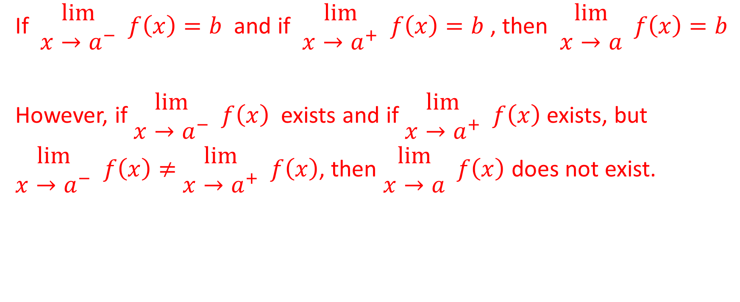
Statement About Limits
If $\begin{matrix}lim⁡ \\ x→a^{−}\end{matrix} f\left(x\right)=b$ and if $\begin{matrix}lim⁡ \\ x→a^{+}\end{matrix} f\left(x\right)=b$ , then $\begin{matrix}lim⁡ \\ x→a\end{matrix} f\left(x\right)=b$
However, if $\begin{matrix}lim⁡ \\ x→a^{−}\end{matrix} f\left(x\right)$ exists and if $\begin{matrix}lim⁡ \\ x→a^{+}\end{matrix} f\left(x\right)$ exists, but
$\begin{matrix}lim⁡ \\ x→a^{−}\end{matrix} f\left(x\right)≠$ $\begin{matrix}lim⁡ \\ x→a^{+}\end{matrix} f\left(x\right)$, then $\begin{matrix}lim⁡ \\ x→a\end{matrix} f\left(x\right)$ does not exist.

Slide 34
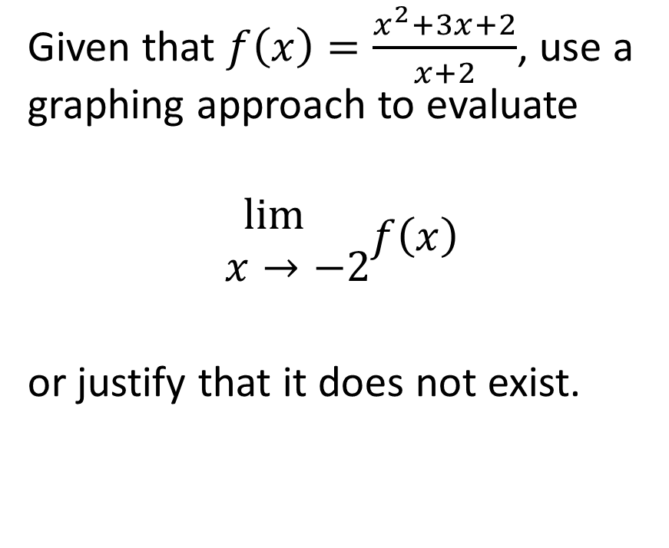
Example
Given that $f\left(x\right)=\frac{x^{2}+3x+2}{x+2}$, use a graphing approach to evaluate
$$\begin{matrix}\lim{} \\ x→−2\end{matrix}f\left(x\right)$$
or justify that it does not exist.

Slide 35
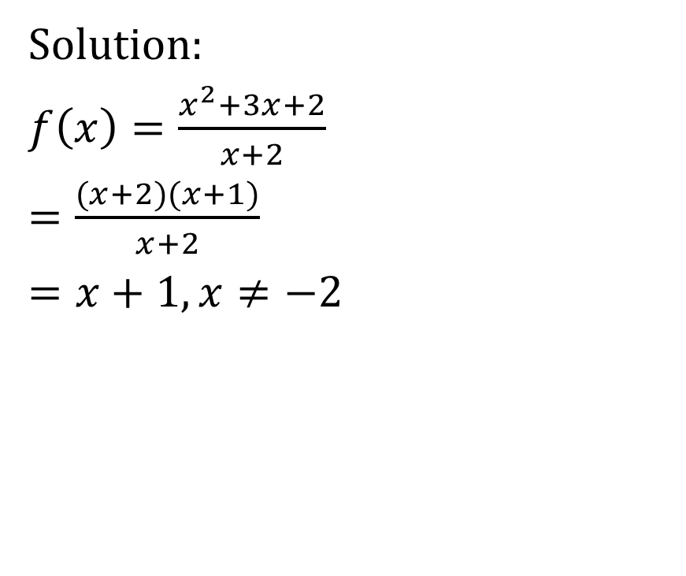
Solution:
$f\left(x\right)=\frac{x^{2}+3x+2}{x+2}$
$=\frac{(x+2)(x+1)}{x+2}$
$=x+1,x≠−2$

Slide 36
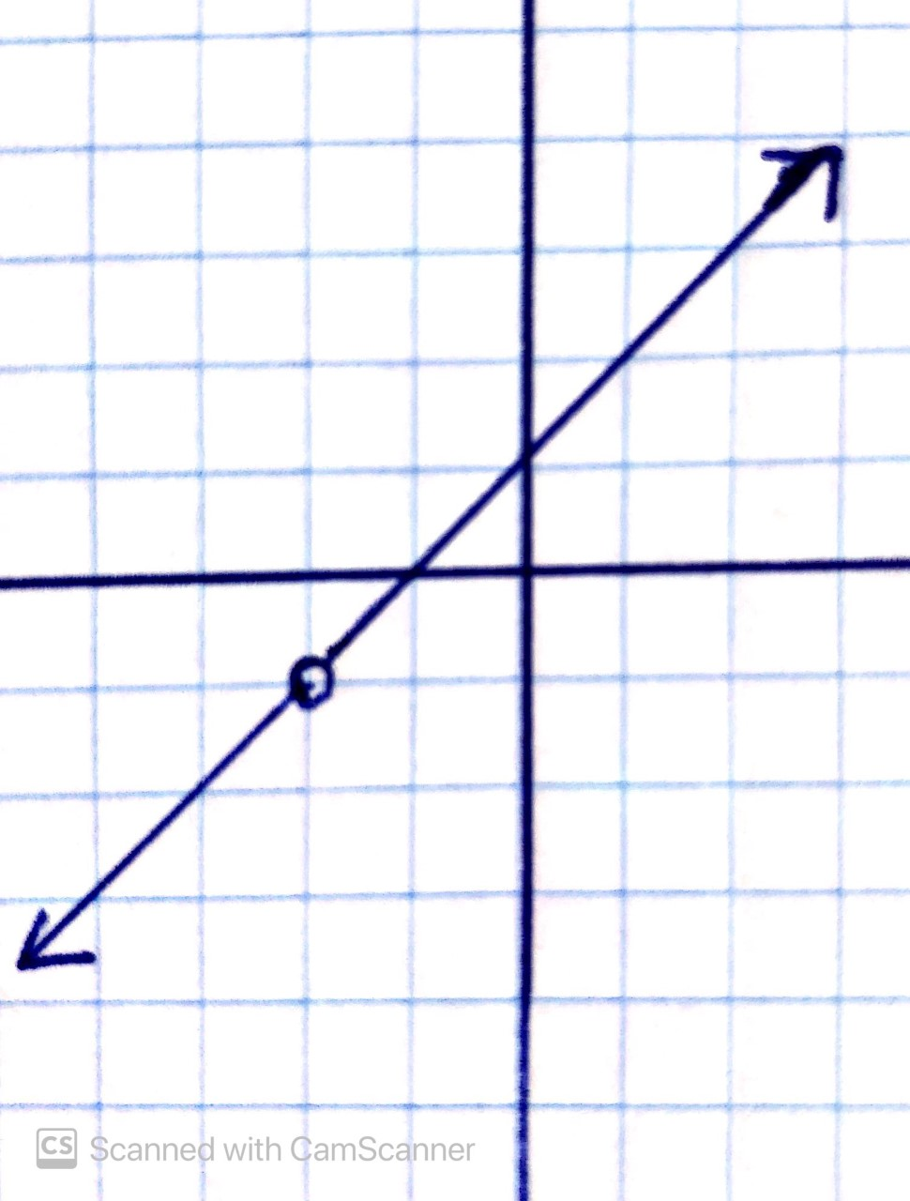
Solution:
$f\left(x\right)=\frac{x^{2}+3x+2}{x+2}$
$=\frac{(x+2)(x+1)}{x+2}$
$=x+1,x≠−2$

Slide 37
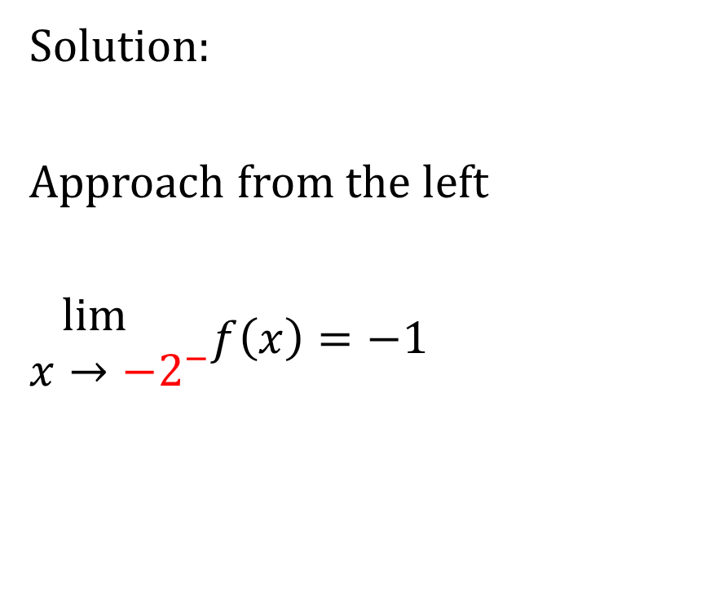

Solution:
Approach from the left
$\begin{matrix}\lim{} \\ x→−2^{−}\end{matrix}f\left(x\right)=−1$

Slide 38
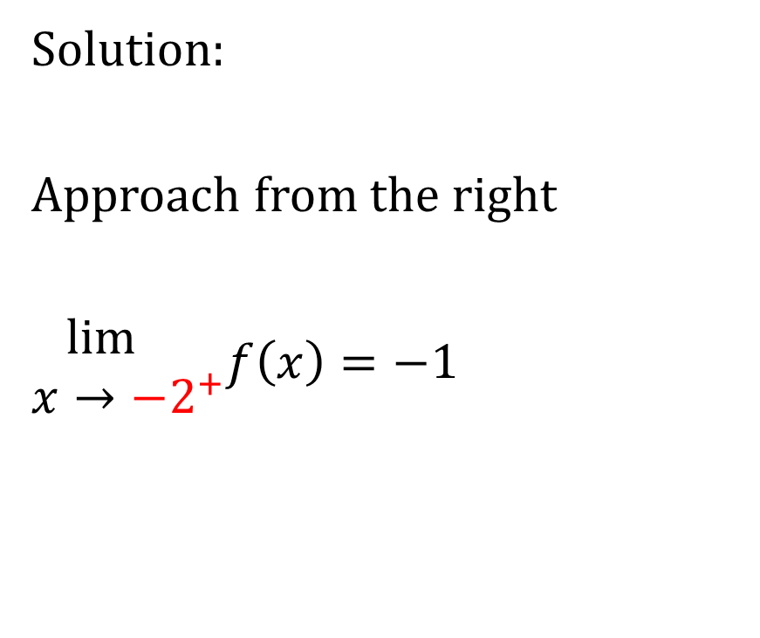

Solution:
Approach from the right
$\begin{matrix}\lim{} \\ x→−2^{+}\end{matrix}f\left(x\right)=−1$

Slide 39
Solution:
Since the limit of f(x) as x approaches -2 from the left equals the limit of f(x) as x approaches -2 from the right, therefore the limit as x approaches -2 exists, and is equal to the common value.

Slide 40
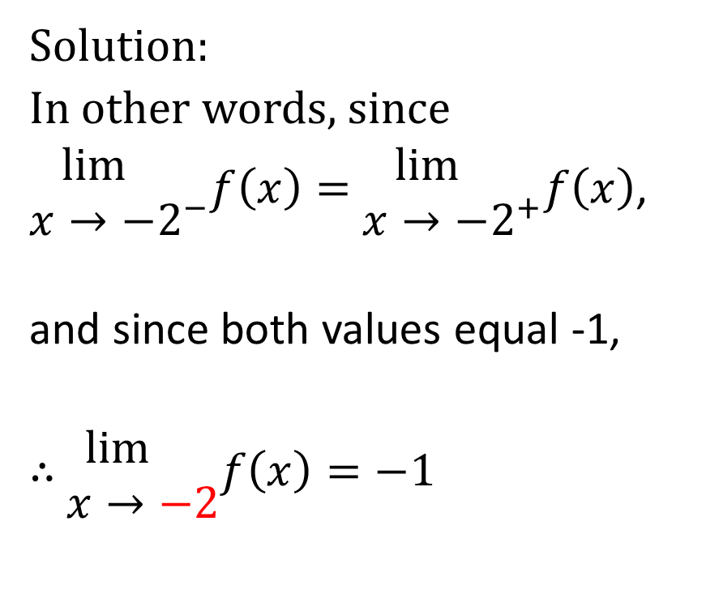
Solution:
In other words, since
$\begin{matrix}\lim{} \\ x→−2^{−}\end{matrix}f\left(x\right)=$ $\begin{matrix}\lim{} \\ x→−2^{+}\end{matrix}f\left(x\right)$,
and since both values equal -1,
$∴$ $\begin{matrix}\lim{} \\ x→−2\end{matrix}f\left(x\right)=−1$

Slide 41
So the lesson to be learned from this example is that it is possible for a function to be undefined at a particular x-value, but for the limit of that function as x approaches that value to exist.
In fact, this is a very common occurrence when we get in to algebraically evaluating limits

Slide 42
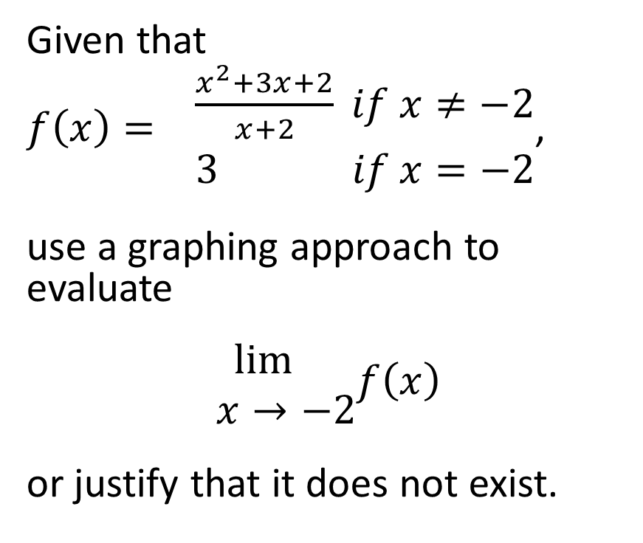
Example
Given that
$f\left(x\right)= \begin{matrix}\frac{x^{2}+3x+2}{x+2} if x≠−2 \\ 3 if x=−2\end{matrix}$,
use a graphing approach to evaluate
$$\begin{matrix}\lim{} \\ x→−2\end{matrix}f\left(x\right)$$
or justify that it does not exist.

Slide 43
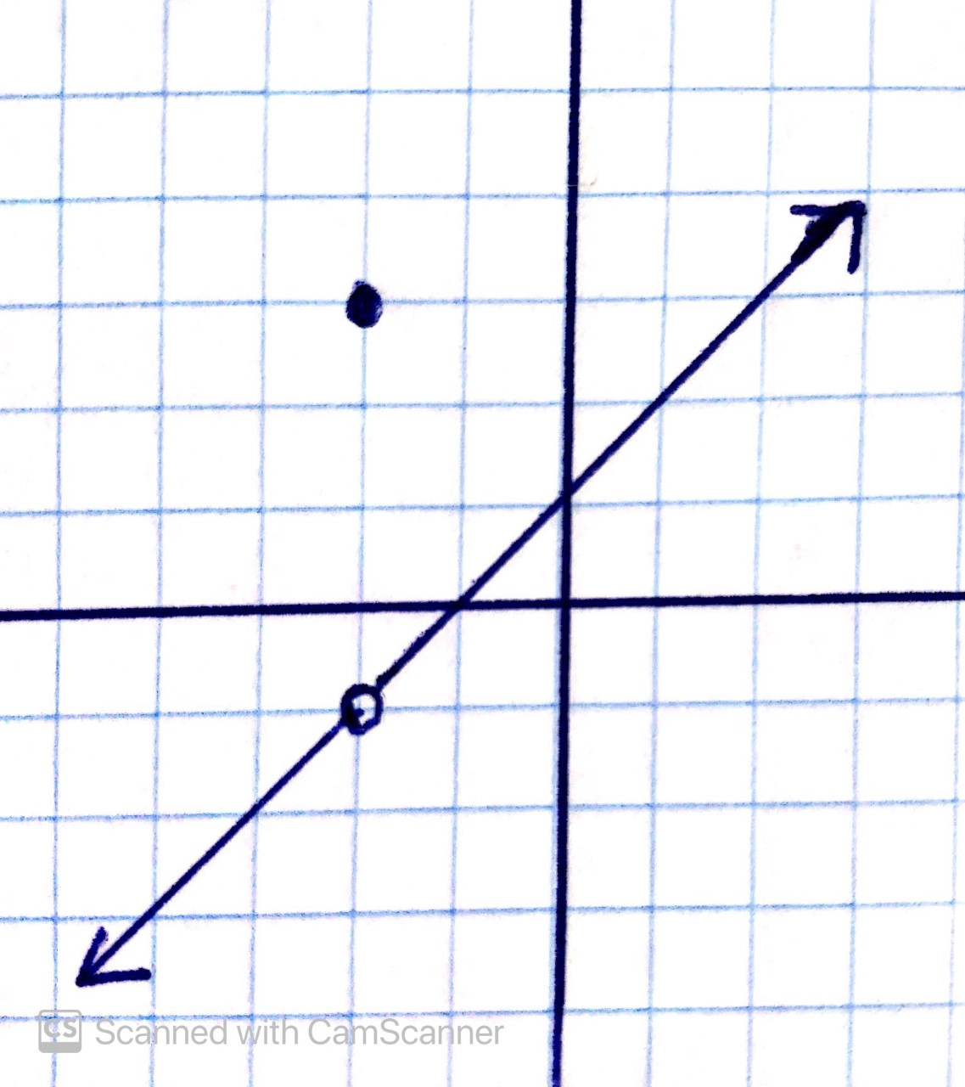
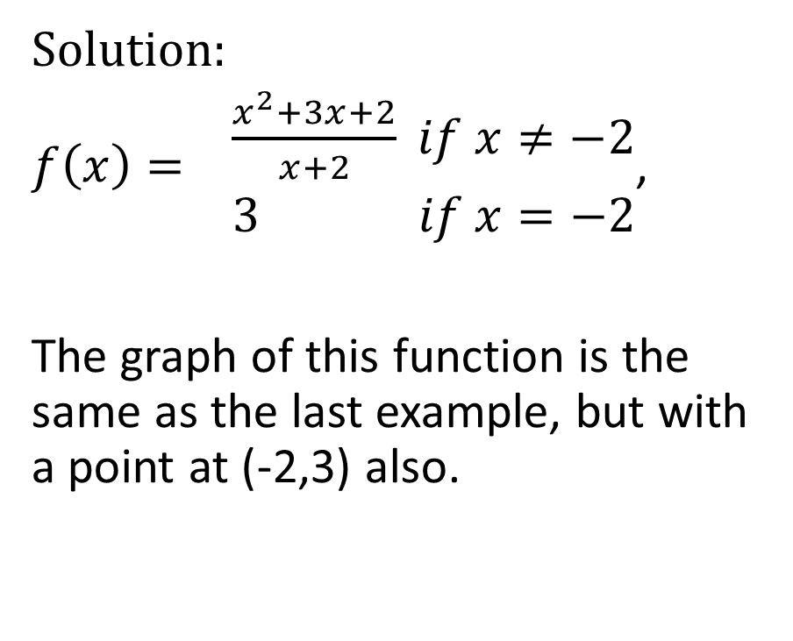
Solution:
$f\left(x\right)= \begin{matrix}\frac{x^{2}+3x+2}{x+2} if x≠−2 \\ 3 if x=−2\end{matrix}$,
The graph of this function is the same as the last example, but with a point at (-2,3) also.

Slide 44

Solution:
Approach from the left
$\begin{matrix}\lim{} \\ x→−2^{−}\end{matrix}f\left(x\right)=−1$

Slide 45
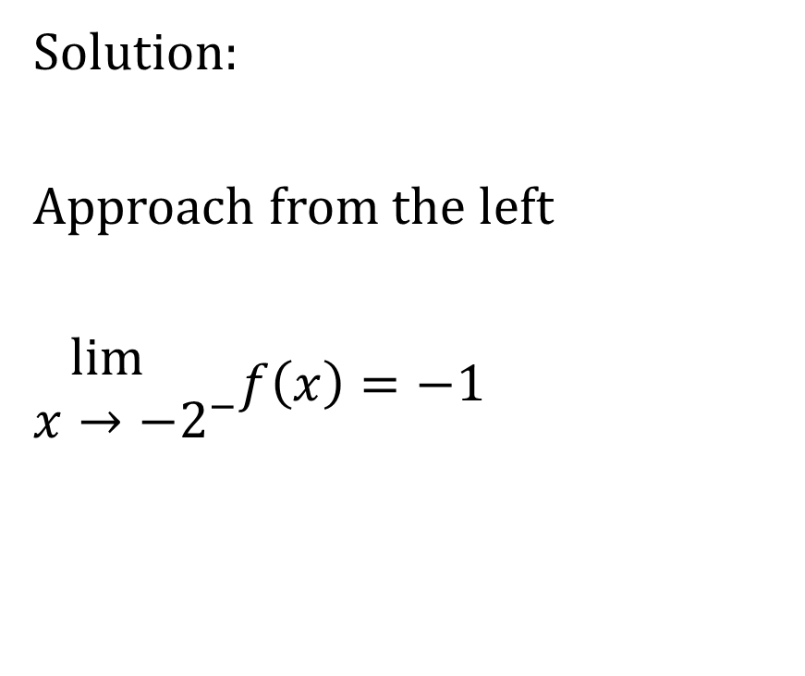
Solution:
Approach from the left
$\begin{matrix}\lim{} \\ x→−2^{−}\end{matrix}f\left(x\right)=−1$
Note that we are not looking at the value of the function at x=-2. Rather, we are looking at the values of y as x approaches -2 from the left.

Slide 46
Solution:
Approach from the left
$\begin{matrix}\lim{} \\ x→−2^{−}\end{matrix}f\left(x\right)=−1$
As x approaches -2 from the left, the values of y go from -2 to -1.1 to -1.01 to -1.001, etc. This pattern is leading us to -1, NOT to 3.

Slide 47

Solution:
Approach from the right
$\begin{matrix}\lim{} \\ x→−2^{+}\end{matrix}f\left(x\right)=−1$

Slide 48
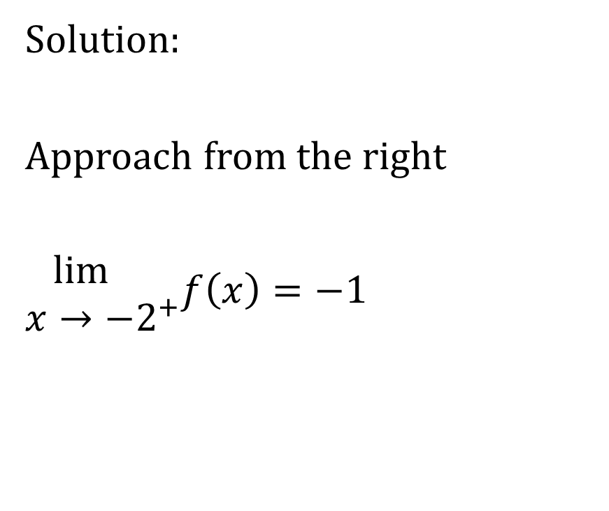

Solution:
Approach from the right
$\begin{matrix}\lim{} \\ x→−2^{+}\end{matrix}f\left(x\right)=−1$
Note that we are not looking at the value of the function at x=-2. Rather, we are looking at the values of y as x approaches -2 from the right.

Slide 49

Solution:
Approach from the right
$\begin{matrix}\lim{} \\ x→−2^{+}\end{matrix}f\left(x\right)=−1$
As x approaches -2 from the right, the values of y go from 0 to -0.9 to -0.99 to -0.999, etc. This pattern is leading us to -1, NOT to 3.

Slide 50
Solution:
From these examples, we see that the limit of the function as x approaches -2 from the left equals the limit of the function as x approaches -2 from the right.
Therefore, the limit of the function as x approaches -2 is equal to this common value

Slide 51
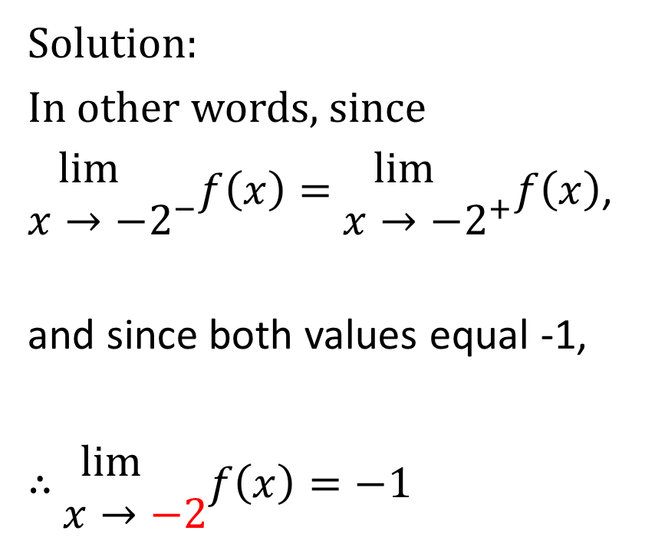
Solution:
In other words, since
$\begin{matrix}\lim{} \\ x→−2^{−}\end{matrix}f\left(x\right)=$ $\begin{matrix}\lim{} \\ x→−2^{+}\end{matrix}f\left(x\right)$,
and since both values equal -1,
$∴$ $\begin{matrix}\lim{} \\ x→−2\end{matrix}f\left(x\right)=−1$

Slide 52
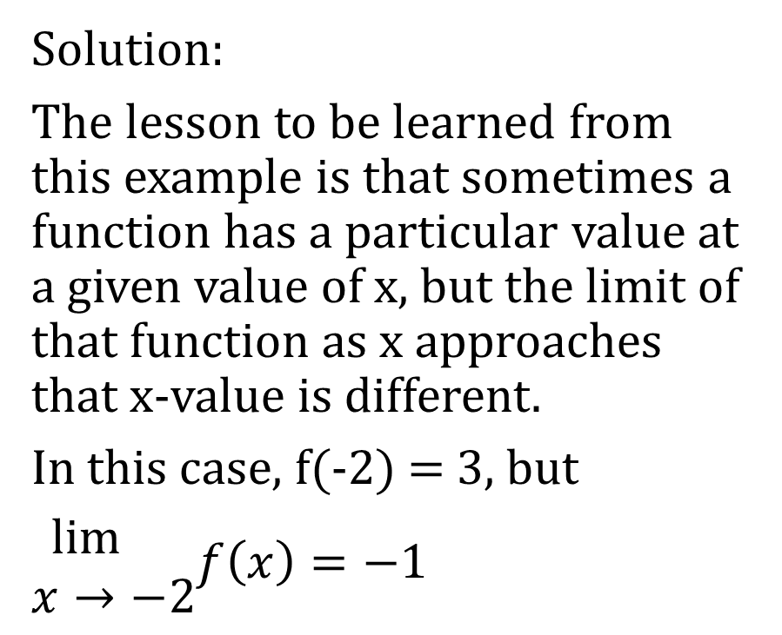
Solution:
The lesson to be learned from this example is that sometimes a function has a particular value at a given value of x, but the limit of that function as x approaches that x-value is different.
In this case, f(-2) = 3, but
$\begin{matrix}\lim{} \\ x→−2\end{matrix}f\left(x\right)=−1$

Slide 53
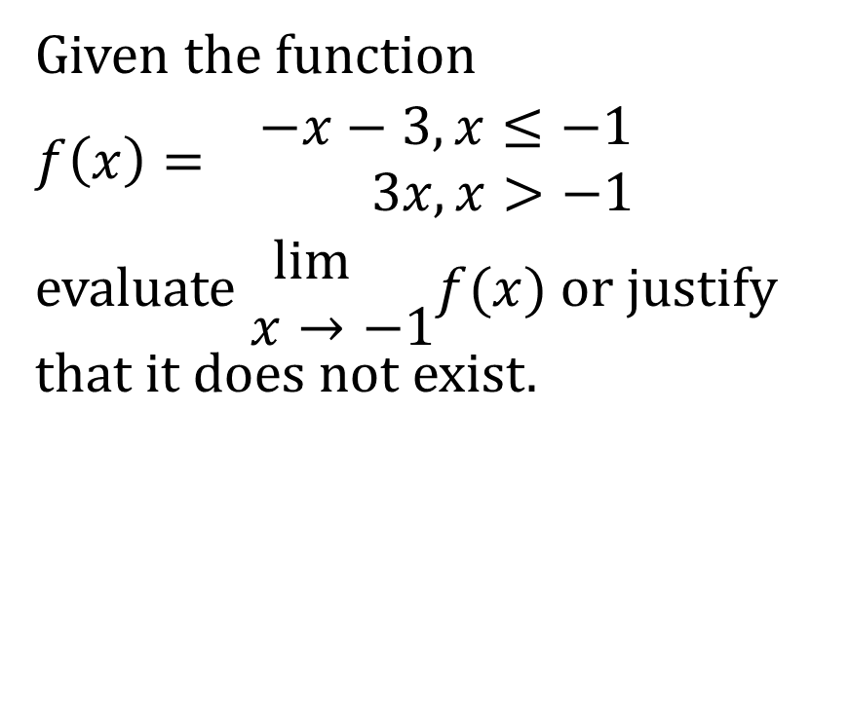
Example
Given the function
$f\left(x\right)= \begin{matrix}−x−3,x≤−1 \\ 3x,x>−1\end{matrix}$
evaluate $\begin{matrix}\lim{} \\ x→−1\end{matrix}f(x)$ or justify that it does not exist.

Slide 54
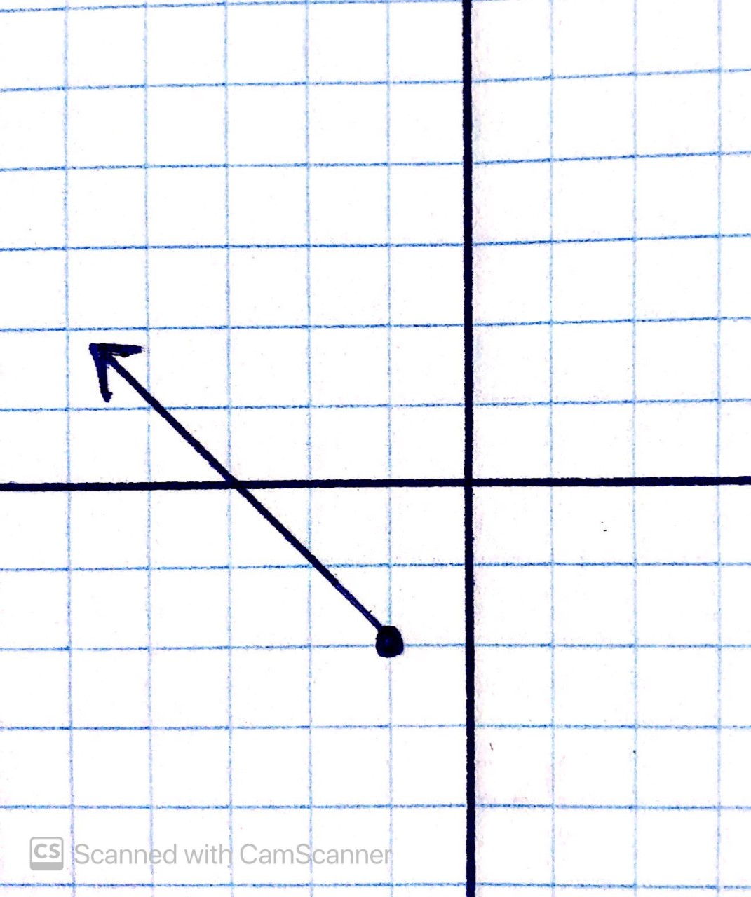
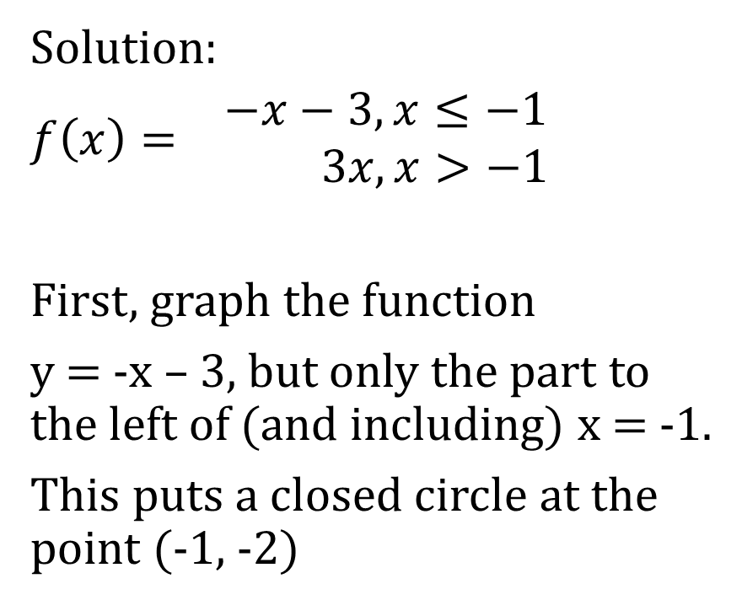
Solution:
$f\left(x\right)= \begin{matrix}−x−3,x≤−1 \\ 3x,x>−1\end{matrix}$
First, graph the function
y = -x – 3, but only the part to the left of (and including) x = -1.
This puts a closed circle at the point (-1, -2)

Slide 55
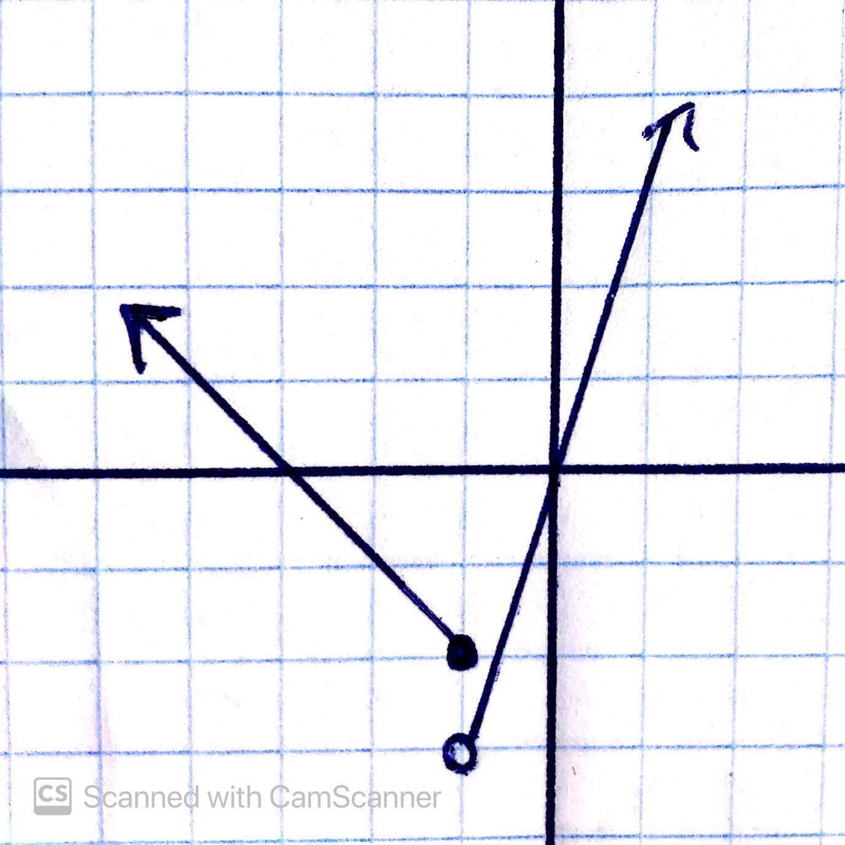
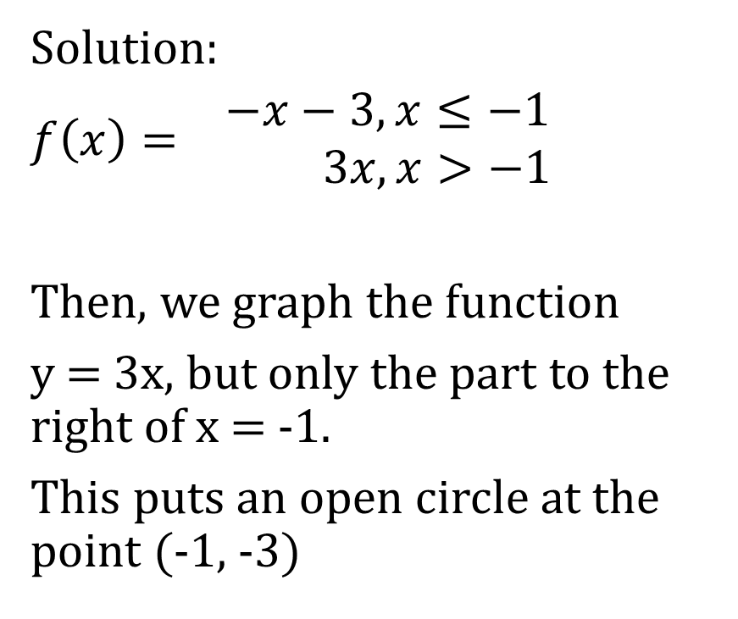
Solution:
$f\left(x\right)= \begin{matrix}−x−3,x≤−1 \\ 3x,x>−1\end{matrix}$
Then, we graph the function
y = 3x, but only the part to the right of x = -1.
This puts an open circle at the point (-1, -3)

Slide 56

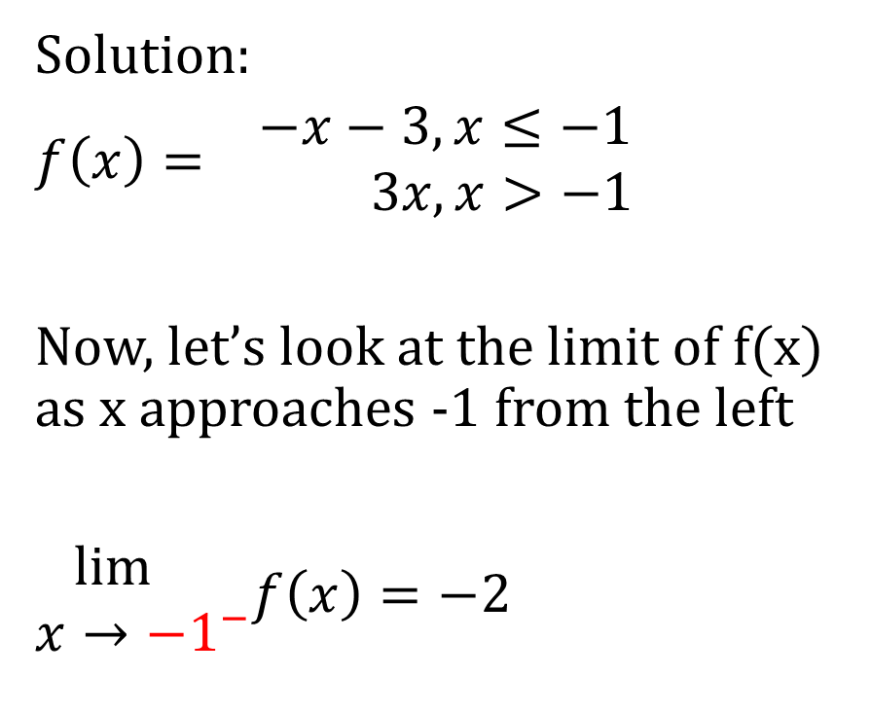
Solution:
$f\left(x\right)= \begin{matrix}−x−3,x≤−1 \\ 3x,x>−1\end{matrix}$
Now, let’s look at the limit of f(x) as x approaches -1 from the left
$\begin{matrix}\lim{} \\ x→−1^{−}\end{matrix}f\left(x\right)=−2$

Slide 57
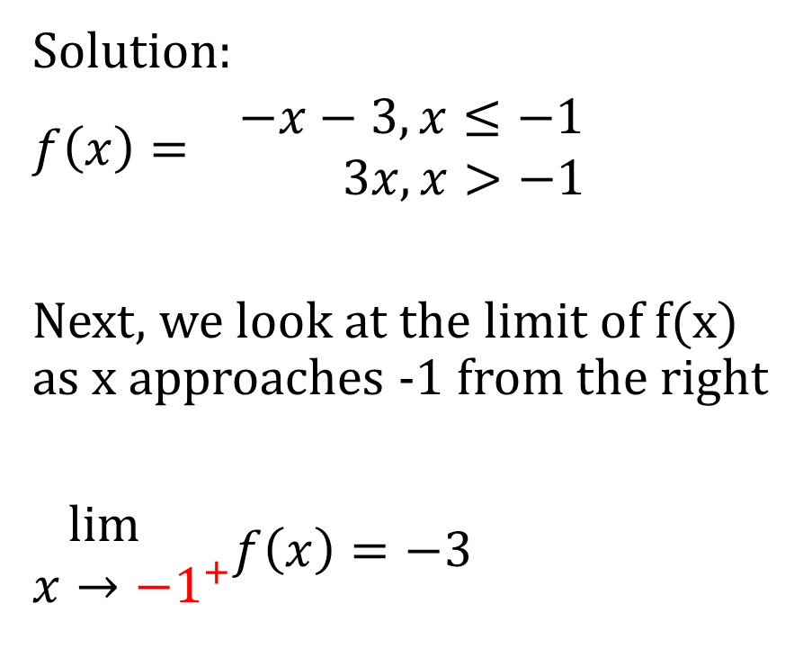
Solution:
$f\left(x\right)= \begin{matrix}−x−3,x≤−1 \\ 3x,x>−1\end{matrix}$
Next, we look at the limit of f(x) as x approaches -1 from the right
$\begin{matrix}\lim{} \\ x→−1^{+}\end{matrix}f\left(x\right)=−3$

Slide 58
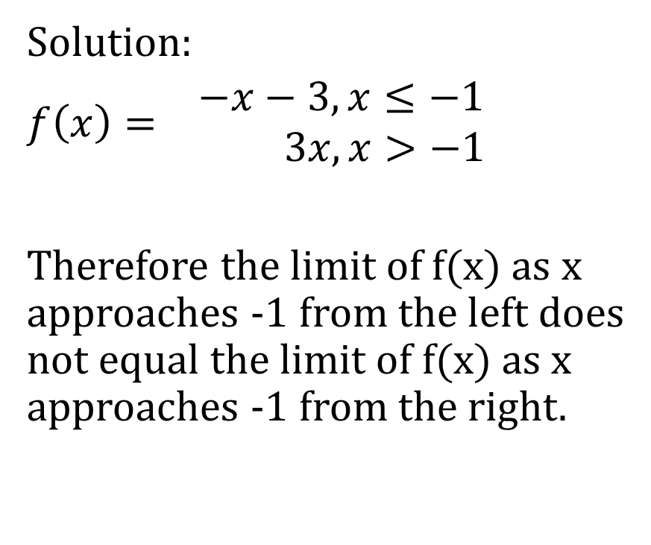
Solution:
$f\left(x\right)= \begin{matrix}−x−3,x≤−1 \\ 3x,x>−1\end{matrix}$
Therefore the limit of f(x) as x approaches -1 from the left does not equal the limit of f(x) as x approaches -1 from the right.

Slide 59
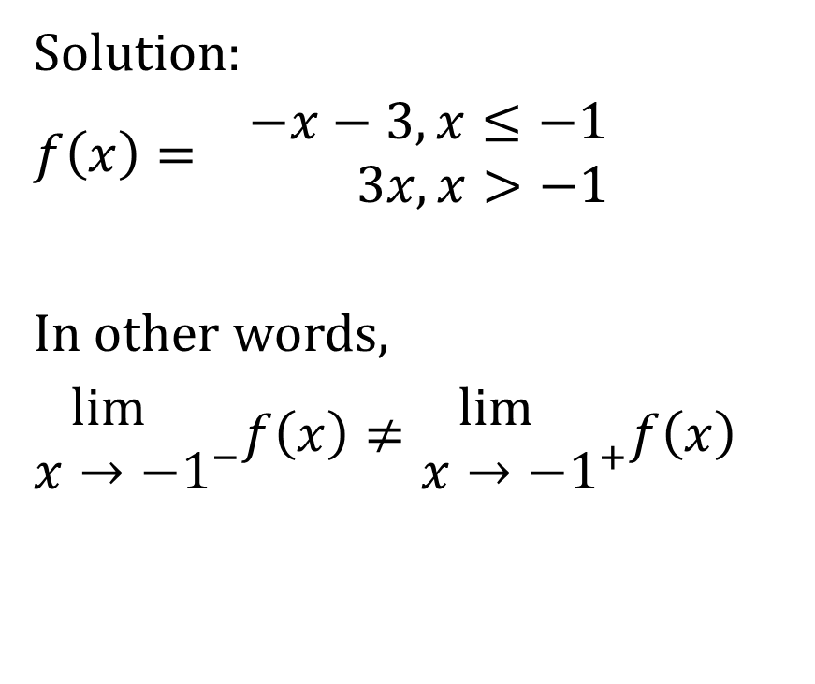
Solution:
$f\left(x\right)= \begin{matrix}−x−3,x≤−1 \\ 3x,x>−1\end{matrix}$
In other words,
$\begin{matrix}\lim{} \\ x→−1^{−}\end{matrix}f\left(x\right)≠\begin{matrix}\lim{} \\ x→−1^{+}\end{matrix}f\left(x\right)$

Slide 60
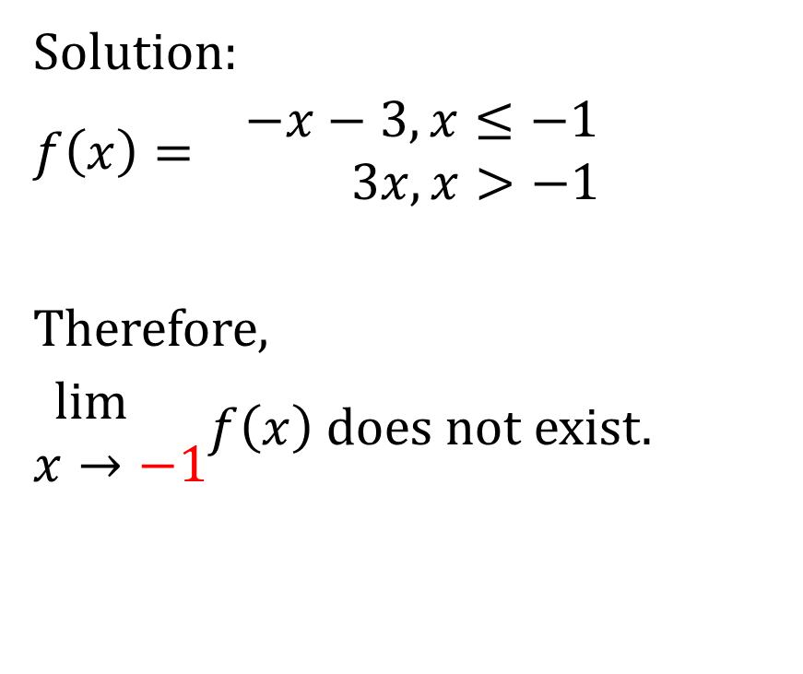
Solution:
$f\left(x\right)= \begin{matrix}−x−3,x≤−1 \\ 3x,x>−1\end{matrix}$
Therefore,
$\begin{matrix}\lim{} \\ x→−1\end{matrix}f\left(x\right)$ does not exist.

Slide 61
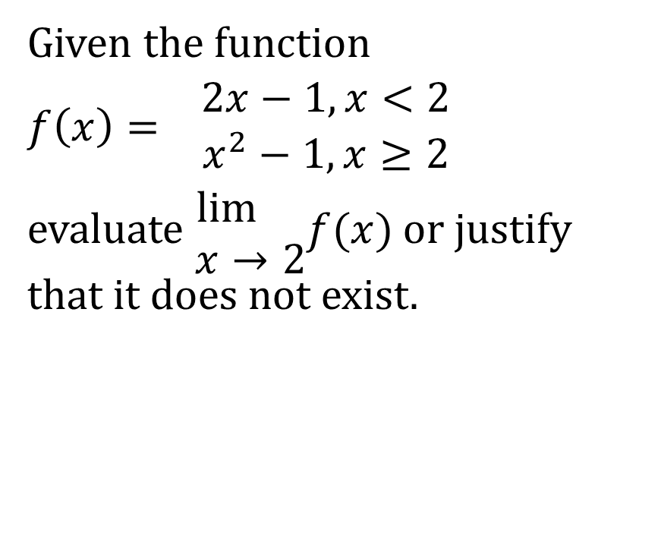
Example
Given the function
$f\left(x\right)= \begin{matrix}2x−1,x<2 \\ x^{2}−1,x≥2\end{matrix}$
evaluate $\begin{matrix}\lim{} \\ x→2\end{matrix}f(x)$ or justify that it does not exist.

Slide 62
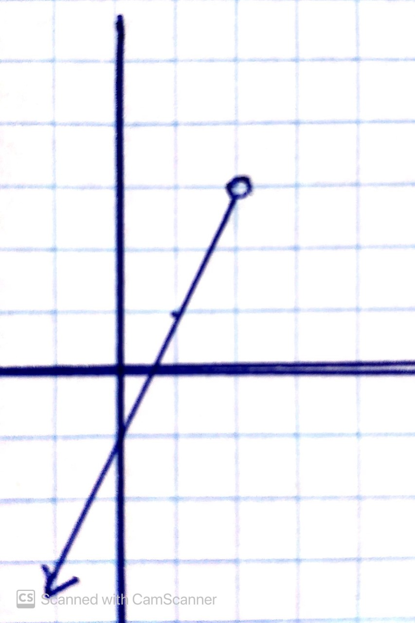
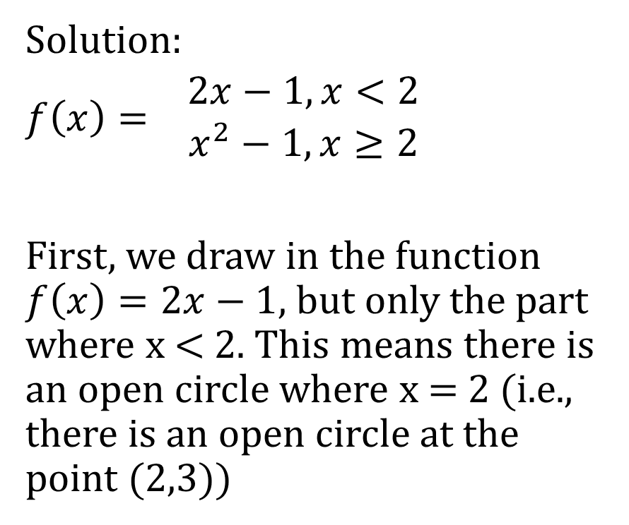
Solution:
$f\left(x\right)= \begin{matrix}2x−1,x<2 \\ x^{2}−1,x≥2\end{matrix}$
First, we draw in the function $f\left(x\right)=2x−1$, but only the part where x < 2. This means there is an open circle where x = 2 (i.e., there is an open circle at the point (2,3))

Slide 63
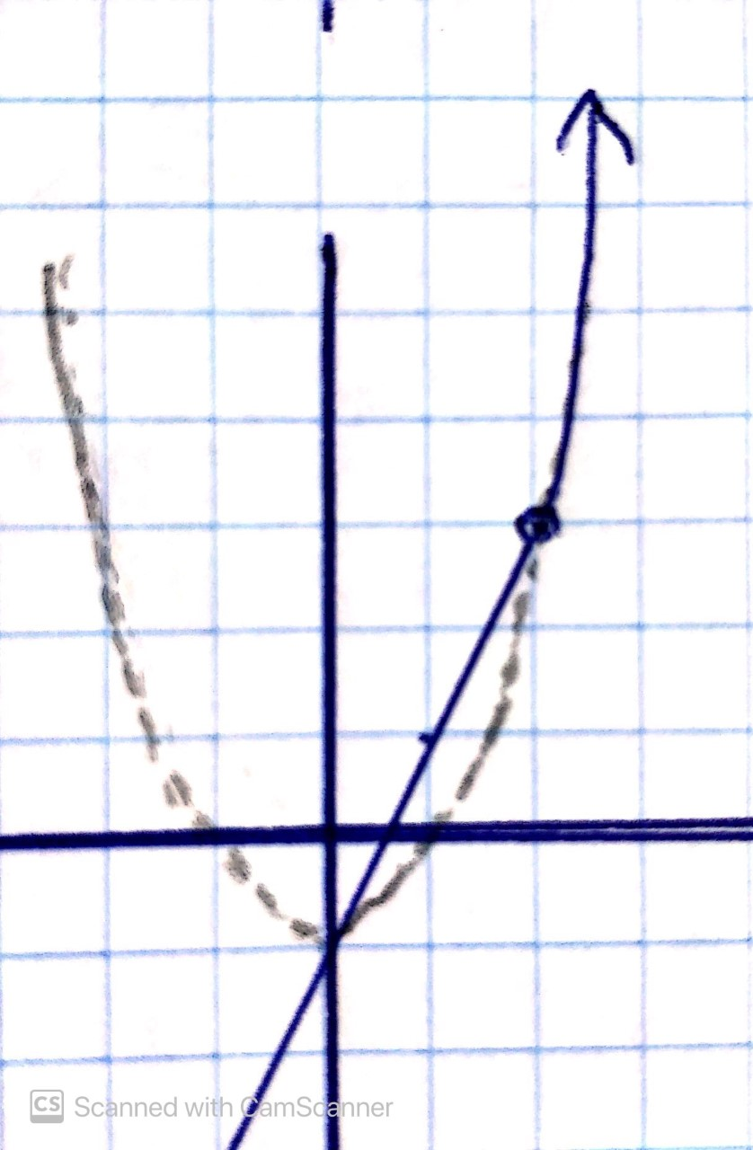
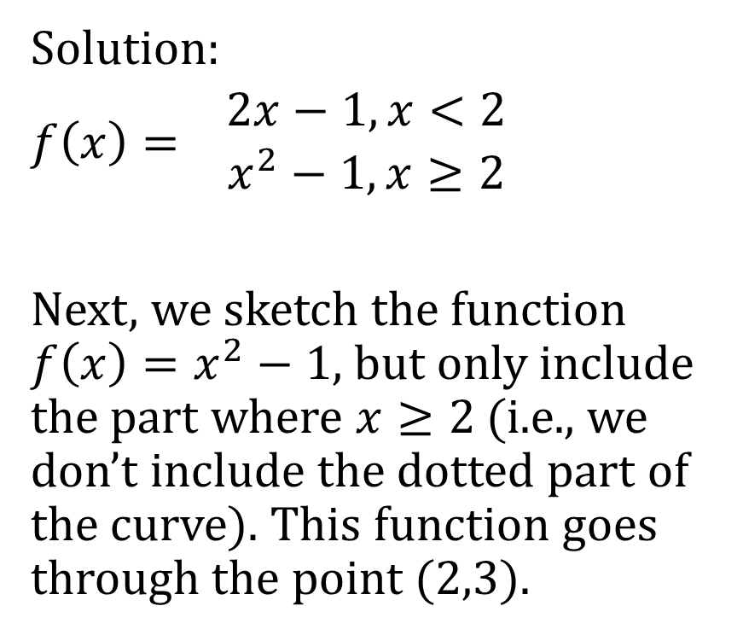
Solution:
$f\left(x\right)= \begin{matrix}2x−1,x<2 \\ x^{2}−1,x≥2\end{matrix}$
Next, we sketch the function $f\left(x\right)=x^{2}−1,$but only include the part where $x≥2$ (i.e., we don’t include the dotted part of the curve). This function goes through the point (2,3).

Slide 64
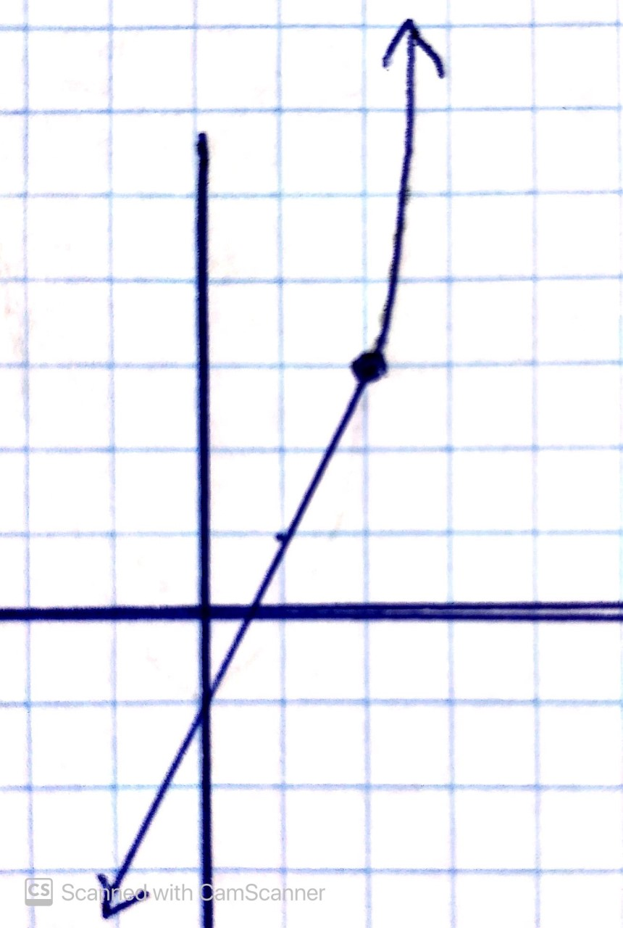
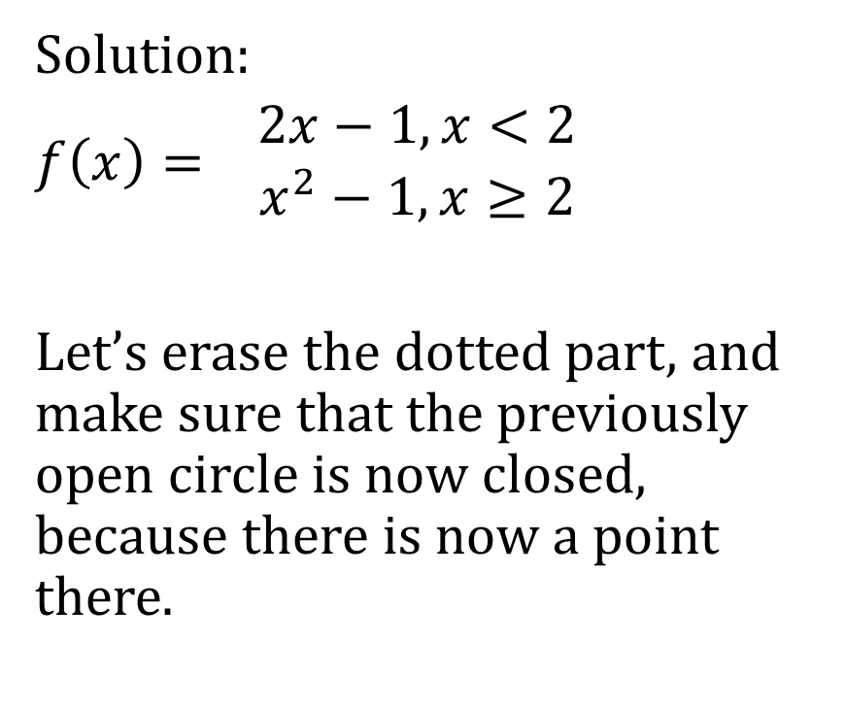
Solution:
$f\left(x\right)= \begin{matrix}2x−1,x<2 \\ x^{2}−1,x≥2\end{matrix}$
Let’s erase the dotted part, and make sure that the previously open circle is now closed, because there is now a point there.

Slide 65

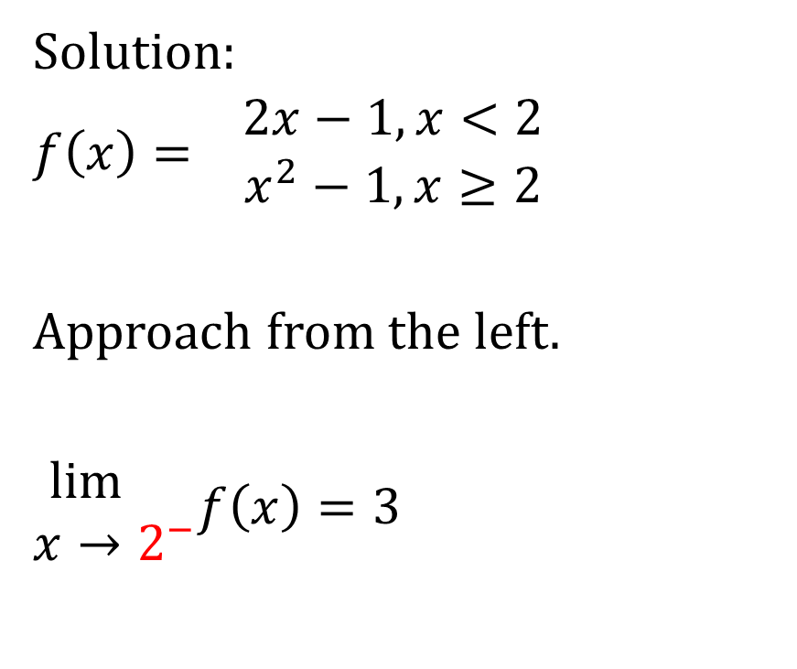
Solution:
$f\left(x\right)= \begin{matrix}2x−1,x<2 \\ x^{2}−1,x≥2\end{matrix}$
Approach from the left.
$\begin{matrix}\lim{} \\ x→2^{−}\end{matrix}f\left(x\right)=3$

Slide 66
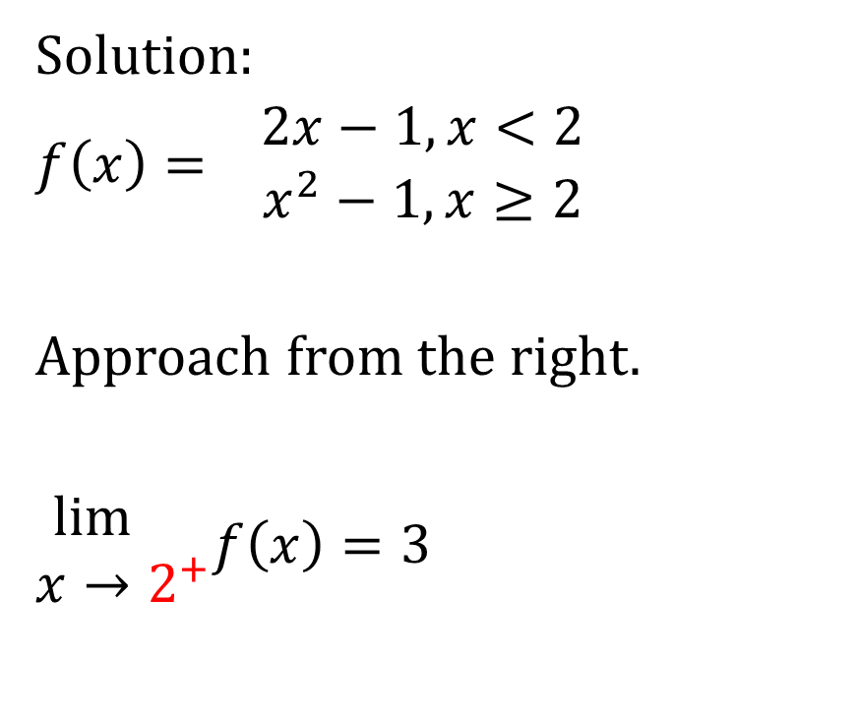
Solution:
$f\left(x\right)= \begin{matrix}2x−1,x<2 \\ x^{2}−1,x≥2\end{matrix}$
Approach from the right.
$\begin{matrix}\lim{} \\ x→2^{+}\end{matrix}f\left(x\right)=3$

Slide 67
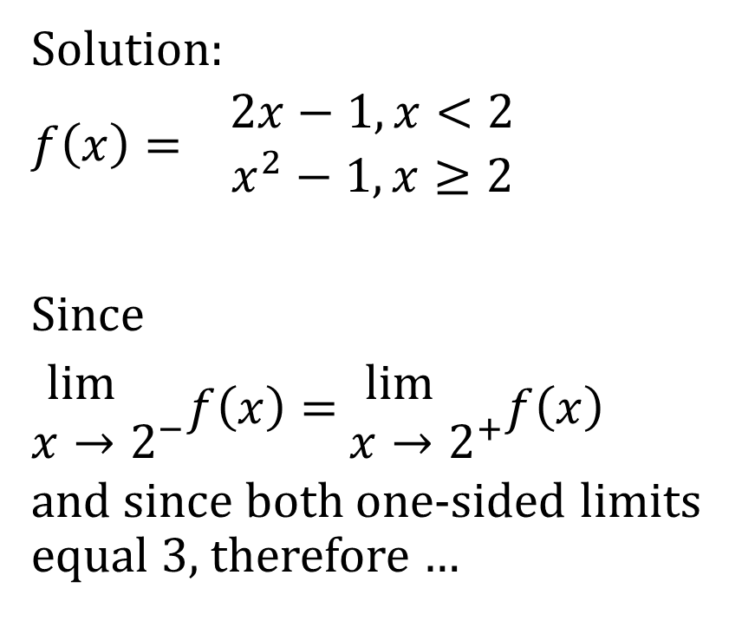
Solution:
$f\left(x\right)= \begin{matrix}2x−1,x<2 \\ x^{2}−1,x≥2\end{matrix}$
Since
$\begin{matrix}\lim{} \\ x→2^{−}\end{matrix}f\left(x\right)=$ $\begin{matrix}\lim{} \\ x→2^{+}\end{matrix}f\left(x\right)$
and since both one-sided limits equal 3, therefore …

Slide 68
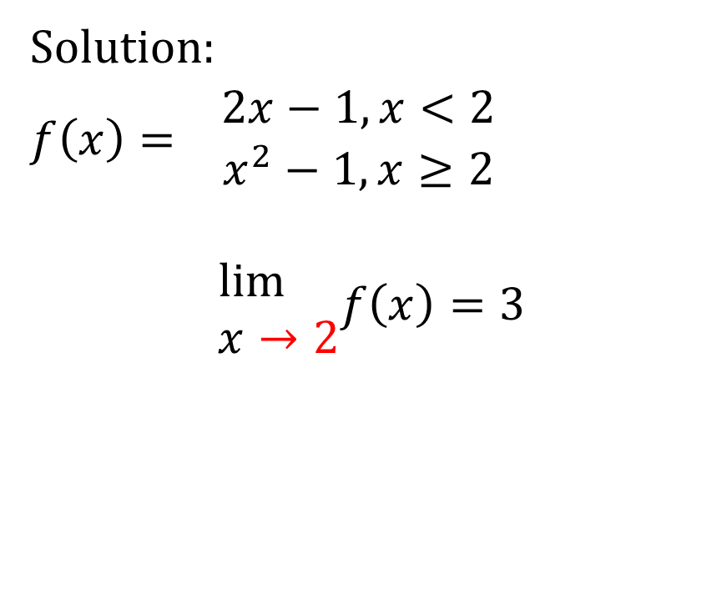
Solution:
$f\left(x\right)= \begin{matrix}2x−1,x<2 \\ x^{2}−1,x≥2\end{matrix}$
$$\begin{matrix}\lim{} \\ x→2\end{matrix}f\left(x\right)=3$$

Slide 69
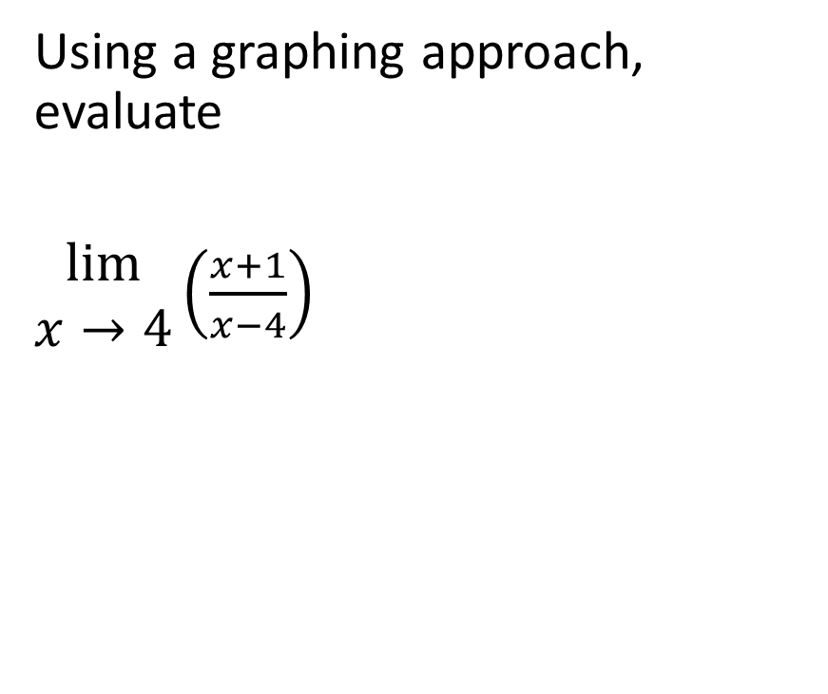
Example
Using a graphing approach, evaluate
$\begin{matrix}lim⁡ \\ x→4\end{matrix}\left(\frac{x+1}{x−4}\right)$

Slide 70
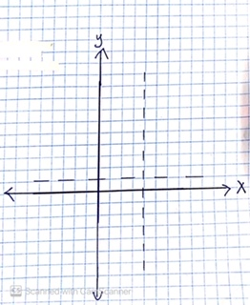
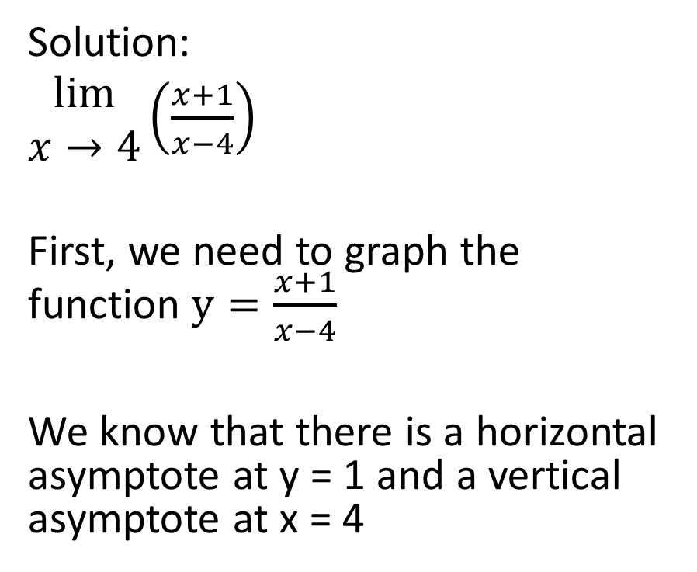
Solution:
$\begin{matrix}lim⁡ \\ x→4\end{matrix}\left(\frac{x+1}{x−4}\right)$
First, we need to graph the function $y=\frac{x+1}{x−4}$
We know that there is a horizontal asymptote at y = 1 and a vertical asymptote at x = 4

Slide 71
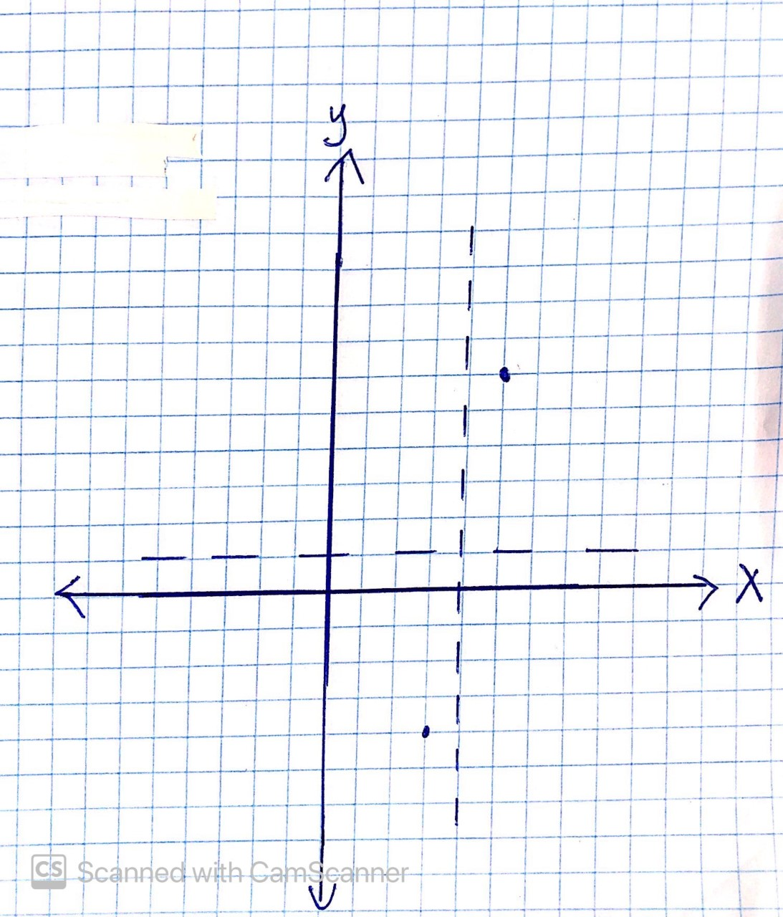

Solution:
$\begin{matrix}lim⁡ \\ x→4\end{matrix}\left(\frac{x+1}{x−4}\right)$
At x = 3, $y=\frac{3+1}{3−4}=−4$
At x = 5, $y=\frac{5+1}{5−4}=6$

Slide 72


Solution:
$\begin{matrix}lim⁡ \\ x→4\end{matrix}\left(\frac{x+1}{x−4}\right)$
y – intercept implies x = 0
$y=\frac{0+1}{0−4}=\frac{−1}{4}$
x – intercept implies y = 0
$\frac{x+1}{x−4}=0$→ x + 1 = 0 → x = -1

Slide 73


Solution:
$\begin{matrix}lim⁡ \\ x→4\end{matrix}\left(\frac{x+1}{x−4}\right)$
Approach from the left
$\begin{matrix}lim⁡ \\ x→4^{−}\end{matrix}\left(\frac{x+1}{x−4}\right)=−∞$

Slide 74

Solution:
$\begin{matrix}lim⁡ \\ x→4\end{matrix}\left(\frac{x+1}{x−4}\right)$
Approach from the right
$\begin{matrix}lim⁡ \\ x→4^{+}\end{matrix}\left(\frac{x+1}{x−4}\right)=∞$

Slide 75

Solution:
$\begin{matrix}lim⁡ \\ x→4\end{matrix}\left(\frac{x+1}{x−4}\right)$
Since
$\begin{matrix}lim⁡ \\ x→4^{−}\end{matrix}\left(\frac{x+1}{x−4}\right)≠$ $\begin{matrix}lim⁡ \\ x→4^{+}\end{matrix}\left(\frac{x+1}{x−4}\right)$ ,
therefore …

Slide 76

Solution:
$\begin{matrix}lim⁡ \\ x→4\end{matrix}\left(\frac{x+1}{x−4}\right)$
$\begin{matrix}lim⁡ \\ x→4\end{matrix}\left(\frac{x+1}{x−4}\right)$ does not exist

Slide 77

Clarification
Note that in the last example, we expressed that limits were equal to $∞$ and to $−∞$. Technically, this is not true. Nothing can equal $∞$ or $−∞$, so one could immediately say that $\begin{matrix}lim⁡ \\ x→4\end{matrix}\left(\frac{x+1}{x−4}\right)$ does not exist as soon as one of the one-sided limits is equal to $∞$ or to $−∞$.

Slide 78

Note that in the last example, we expressed that limits were equal to $∞$ and to $−∞$. Technically, this is not true. Nothing can equal $∞$ or $−∞$, so one could immediately say that $\begin{matrix}lim⁡ \\ x→4\end{matrix}\left(\frac{x+1}{x−4}\right)$ does not exist as soon as one of the one-sided limits is equal to $∞$ or to $−∞$. However, in this course we will say that a one sided limit can equal $∞$ or $−∞$(and this will include limits as x is going to $∞$ or to $−∞$, which can only be addressed from one direction).

Slide 79

Note that in the last example, we expressed that limits were equal to $∞$ and to $−∞$. Technically, this is not true. Nothing can equal $∞$ or $−∞$, so one could immediately say that $\begin{matrix}lim⁡ \\ x→4\end{matrix}\left(\frac{x+1}{x−4}\right)$ does not exist as soon as one of the one-sided limits is equal to $∞$ or to $−∞$. However, in this course we will say that a one sided limit can equal $∞$ or $−∞$(and this will include limits as x is going to $∞$ or to $−∞$, which can only be addressed from one direction). However, if we are seeking the limit of a function as x approaches a real number (a two-sided limit) and if one of the one-sided limits is equal to $∞$ or to $−∞,$then we will state that the limit of the function as x approaches the real number does not exist.

Slide 80

For example, we might write any of the following:
$\begin{matrix}\lim{} \\ x→∞\end{matrix}f\left(x\right)=∞$ or $\begin{matrix}\lim{} \\ x→−∞\end{matrix}f\left(x\right)=∞$ or $\begin{matrix}\lim{} \\ x→∞\end{matrix}f\left(x\right)=−∞$ or $\begin{matrix}\lim{} \\ x→−∞\end{matrix}f\left(x\right)=−∞$

Slide 81

For example, we might write any of the following:
$\begin{matrix}\lim{} \\ x→∞\end{matrix}f\left(x\right)=∞$ or $\begin{matrix}\lim{} \\ x→−∞\end{matrix}f\left(x\right)=∞$ or $\begin{matrix}\lim{} \\ x→∞\end{matrix}f\left(x\right)=−∞$ or $\begin{matrix}\lim{} \\ x→−∞\end{matrix}f\left(x\right)=−∞$
Or, we might write any of the following
$\begin{matrix}\lim{} \\ x→4^{+}\end{matrix}f\left(x\right)=∞$ or $\begin{matrix}\lim{} \\ x→4^{−}\end{matrix}f\left(x\right)=∞$ or $\begin{matrix}\lim{} \\ x→4^{+}\end{matrix}f\left(x\right)=−∞$ or $\begin{matrix}\lim{} \\ x→4^{−}\end{matrix}f\left(x\right)=−∞$

Slide 82

For example, we might write any of the following:
$\begin{matrix}\lim{} \\ x→∞\end{matrix}f\left(x\right)=∞$ or $\begin{matrix}\lim{} \\ x→−∞\end{matrix}f\left(x\right)=∞$ or $\begin{matrix}\lim{} \\ x→∞\end{matrix}f\left(x\right)=−∞$ or $\begin{matrix}\lim{} \\ x→−∞\end{matrix}f\left(x\right)=−∞$
Or, we might write any of the following
$\begin{matrix}\lim{} \\ x→4^{+}\end{matrix}f\left(x\right)=∞$ or $\begin{matrix}\lim{} \\ x→4^{−}\end{matrix}f\left(x\right)=∞$ or $\begin{matrix}\lim{} \\ x→4^{+}\end{matrix}f\left(x\right)=−∞$ or $\begin{matrix}\lim{} \\ x→4^{−}\end{matrix}f\left(x\right)=−∞$
But, if we find, for example that $\begin{matrix}\lim{} \\ x→4^{+}\end{matrix}f\left(x\right)=∞$(a one-sided limit), then we can immediately state that $\begin{matrix}\lim{} \\ x→4\end{matrix}f\left(x\right)$ (a two-sided limit) does not exist

Slide 83

Limits that can only be approached from one side
Sometimes, we will come across a limit that can only be approached from the left or from the right. The most common type of limit of this form is when we seek to find the limit of a function as x approaches $∞$ or as x approaches $−∞$.
If we want to evaluate the limit of a function as x approaches $−∞$, we can only approach it from the right, because we can’t be to the left of $−∞$.
Similarly, if we want to evaluate the limit of a function as x approaches $∞$, we can only approach it from the left, because we can’t be to the right of $∞$.

Slide 84

Example
Using a graphing approach, evaluate
$\begin{matrix}lim⁡ \\ x→∞\end{matrix}\left(−x+2\right)$

Slide 85


Solution:
$\begin{matrix}lim⁡ \\ x→∞\end{matrix}\left(−x+2\right)$
First, we graph the function
$y=−x+2$

Slide 86


Notice that we can’t approach $+∞$ from the right hand side. We can only approach from the left.
So, we approach from the left and get the result
$\begin{matrix}lim⁡ \\ x→∞\end{matrix}\left(−x+2\right)=−∞$

Slide 87

Example
Using a graphing approach, evaluate
$\begin{matrix}lim⁡ \\ x→−∞\end{matrix}\left(\frac{1}{x+3}\right)$

Slide 88


Solution:
$\begin{matrix}lim⁡ \\ x→−∞\end{matrix}\left(\frac{1}{x+3}\right)$
First, we take a few steps to graph the curve however you know how.

Slide 89

Solution:
$\begin{matrix}lim⁡ \\ x→−∞\end{matrix}\left(\frac{1}{x+3}\right)$
First, we take a few steps to graph the curve however you know how.

Slide 90

Solution:
$\begin{matrix}lim⁡ \\ x→−∞\end{matrix}\left(\frac{1}{x+3}\right)$
First, we take a few steps to graph the curve however you know how.

Slide 91

Solution:
$\begin{matrix}lim⁡ \\ x→−∞\end{matrix}\left(\frac{1}{x+3}\right)$
First, we take a few steps to graph the curve however you know how.

Slide 92


Solution:
$\begin{matrix}lim⁡ \\ x→−∞\end{matrix}\left(\frac{1}{x+3}\right)$
Next, we can only approach $−∞$ from the right (it is impossible to be to the left of $−∞$).
Therefore, $\begin{matrix}lim⁡ \\ x→−∞\end{matrix}\left(\frac{1}{x+3}\right)=0$

Slide 93

Sometimes people want to say that the limit as x approaches $−∞$is $∞$, because they notice that the y value will always be increasing as x approaches $−∞$.
However, this is not the case. The values of y are getting infinitely close to 0, not to any positive number. Hence, the limit of the function as x approaches $−∞$ is 0.

Slide 94
We see that horizontal asymptotes operate like limits.

Slide 95

Example
Use a graphing approach to evaluate
$\begin{matrix}lim⁡ \\ x→∞\end{matrix}\sin{x}$
or state that it does not exist

Slide 96


Solution:
$\begin{matrix}lim⁡ \\ x→∞\end{matrix}\sin{x}$

Slide 97

Solution:
$\begin{matrix}lim⁡ \\ x→∞\end{matrix}\sin{x}$
As we can see from the graph of the function, this function will vary continually between -1 and 1 forever (it is a periodic function, so it repeats the same value over and over)

Slide 98

Solution:
$\begin{matrix}lim⁡ \\ x→∞\end{matrix}\sin{x}$
Therefore, there is no one value that we can say that the function approaches as x approaches $∞$.

Slide 99

Solution:
$\begin{matrix}lim⁡ \\ x→∞\end{matrix}\sin{x}$
Therefore,
$\begin{matrix}lim⁡ \\ x→∞\end{matrix}\sin{x}$ does not exist.

Slide 100

Example
Evaluate the following using a graphing approach
$\begin{matrix}lim⁡ \\ x→2\end{matrix}\left(\sqrt{x−2}+3\right)$

Slide 101



Solution:
$\begin{matrix}lim⁡ \\ x→2\end{matrix}\left(\sqrt{x−2}+3\right)$
As you can tell, we cannot approach an x value of 2 from the left because the function is not defined to the left of 2. There are no domain values less than 2.

Slide 102

Solution:
$\begin{matrix}lim⁡ \\ x→2\end{matrix}\left(\sqrt{x−2}+3\right)$
In other words,
$\begin{matrix}lim⁡ \\ x→2^{−}\end{matrix}\left(\sqrt{x−2}+3\right)$
does not exist

Slide 103
Solution:
However, in this specific circumstance, where the function is not defined at all on one side of the x-value in question but is defined on the other side, we focus solely on the side on which the function is defined.

Slide 104


Solution:
In other words, we will approach an x-value of 2 from the right.
$\begin{matrix}\lim{} \\ x→2^{+}\end{matrix}f\left(x\right)=3$

Slide 105
Solution:
Since that is the only direction from which we can approach this x-value, therefore we state the value of that one-sided limit as the value of the limit of the function as x approaches 2.

Slide 106

Solution:
In other words,
$\begin{matrix}\lim{} \\ x→2\end{matrix}f\left(x\right)=3$

